Slide 1
Machine Learning Based Low-Cost Multispectral Sensor for Leaf Nitrogen and Phosphorus Level Classification
Mohammad Habibullah

Slide 2
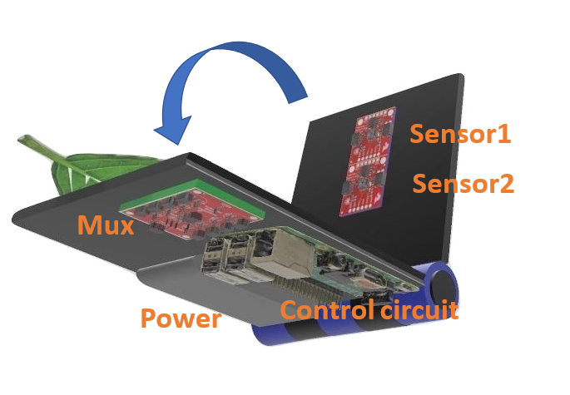
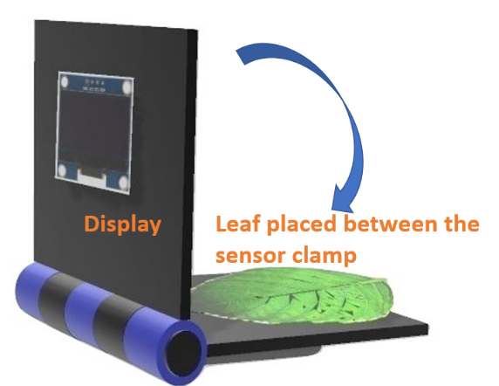
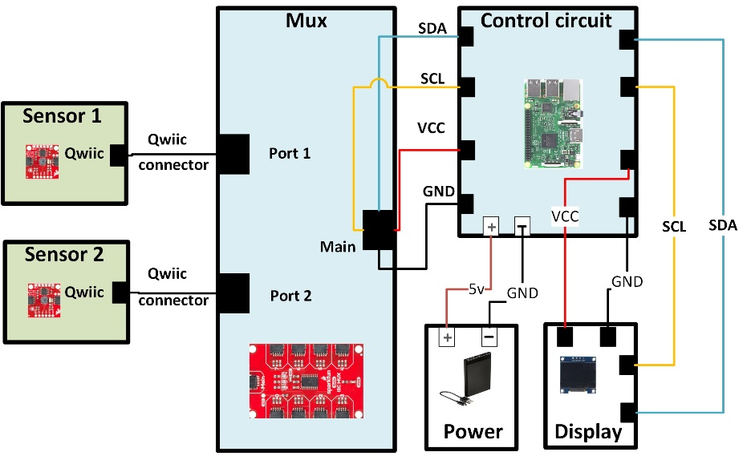
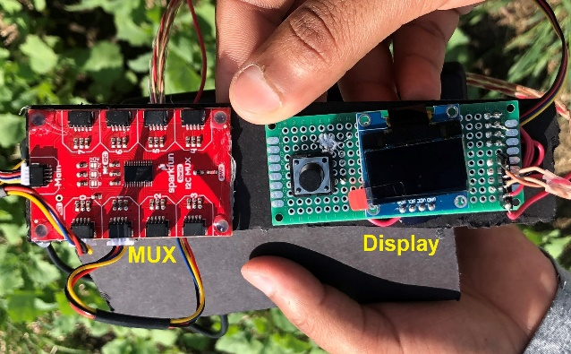
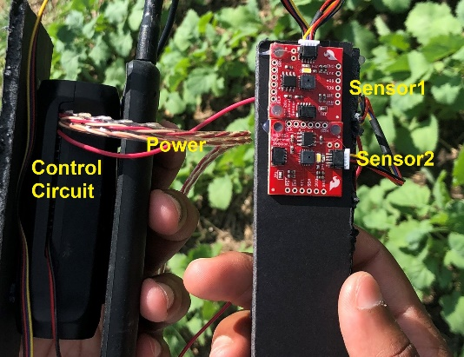
Methodology
Overall setup of the System:

Slide 3
Methodology
State-of-the-art Algorithms:
K- means clustering:
Used in preprocessing stage
Euclidean distance is used
The center of the cluster (centroid) was determined
Ensemble Bagged Decision Tree (EBT):
Used to classify N and P levels in leaves
Support Vector Machine (SVM):
Used to classify N and P levels in leaves
Radial basis function (RBF) is used as kernel
RBF kernel parameters are optimized using the Wang [66]
K-Nearest Neighbor (KNN):
Used to classify N and P levels in leaves
Decision Tree (DT):
Used to classify N and P levels in leaves
C4.5 decision tree is used

Slide 4
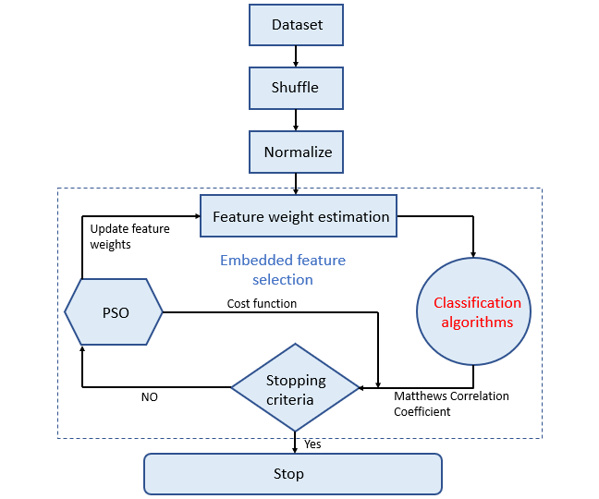
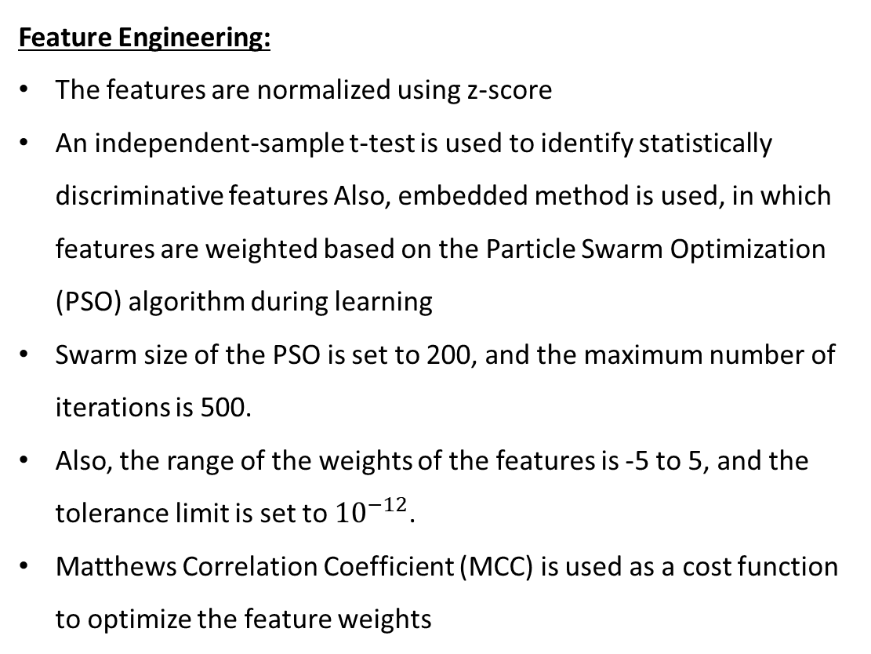
Methodology
Feature Engineering:
The features are normalized using z-score
An independent-sample t-test is used to identify statistically discriminative features Also, embedded method is used, in which features are weighted based on the Particle Swarm Optimization (PSO) algorithm during learning
Swarm size of the PSO is set to 200, and the maximum number of iterations is 500.
Also, the range of the weights of the features is -5 to 5, and the tolerance limit is set to ${10}^{−12}$.
Matthews Correlation Coefficient (MCC) is used as a cost function to optimize the feature weights

Slide 5
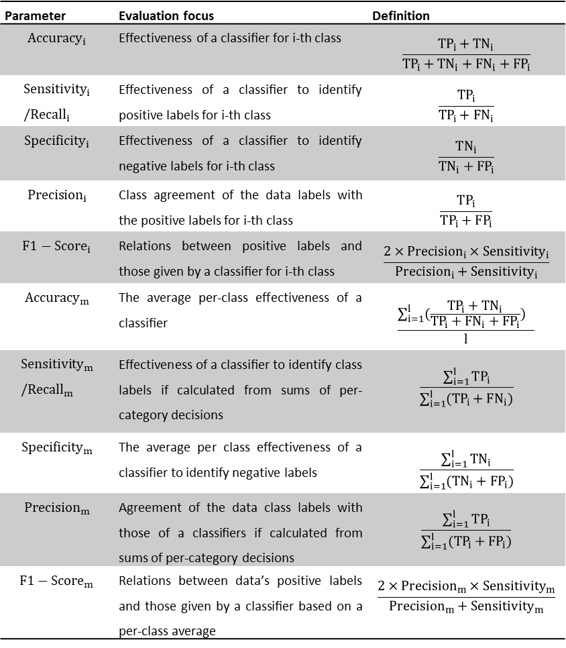
Methodology
Parameter | Evaluation focus | Definition
$${Accuracy}_{i}$$ | Effectiveness of a classiﬁer for i-th class | $$\frac{{TP}_{i}+{TN}_{i}}{{TP}_{i}+{TN}_{i}+{FN}_{i}+{FP}_{i}}$$
$${Sensitivity}_{i}/{Recall}_{i}$$ | Effectiveness of a classiﬁer to identify positive labels for i-th class | $$\frac{TP_{i}}{TP_{i}+FN_{i}}$$
$${Specificity}_{i}$$ | Effectiveness of a classiﬁer to identify negative labels for i-th class | $$\frac{TN_{i}}{TN_{i}+FP_{i}}$$
$${Precision}_{i}$$ | Class agreement of the data labels with the positive labels for i-th class | $$\frac{TP_{i}}{TP_{i}+FP_{i}}$$
$${F1−Score}_{i}$$ | Relations between positive labels and those given by a classiﬁer for i-th class | $$\frac{2×{Precision}_{i}{×Sensitivity}_{i}}{{Precision}_{i}+{Sensitivity}_{i}}$$
$${Accuracy}_{m}$$ | The average per-class effectiveness of a classiﬁer | $$\frac{\sum_{i=1}^{l}{(\frac{{TP}_{i}+{TN}_{i}}{{TP}_{i}+{FN}_{i}+{FP}_{i}}) }}{l}$$
$${Sensitivity}_{m}/{Recall}_{m}$$ | Effectiveness of a classiﬁer to identify class labels if calculated from sums of per-category decisions | $$\frac{\sum_{i=1}^{l}{TP_{i}}}{\sum_{i=1}^{l}{(TP_{i}+FN_{i})}}$$
$${Specificity}_{m}$$ | The average per class effectiveness of a classifier to identify negative labels | $$\frac{\sum_{i=1}^{l}{TN_{i}}}{\sum_{i=1}^{l}{(TN_{i}+FP_{i})}}$$
$${Precision}_{m}$$ | Agreement of the data class labels with those of a classiﬁers if calculated from sums of per-category decisions | $$\frac{\sum_{i=1}^{l}{TP_{i}}}{\sum_{i=1}^{l}{(TP_{i}+FP_{i})}}$$
$${F1−Score}_{m}$$ | Relations between data’s positive labels and those given by a classiﬁer based on a per-class average | $$\frac{2×{Precision}_{m}{×Sensitivity}_{m}}{{Precision}_{m}+{Sensitivity}_{m}}$$
Model Validation:
Hold-out method: 75%-25% split
K-fold cross validation: 5-fold cross validation
Model Validation:
Classification metrics

Slide 6
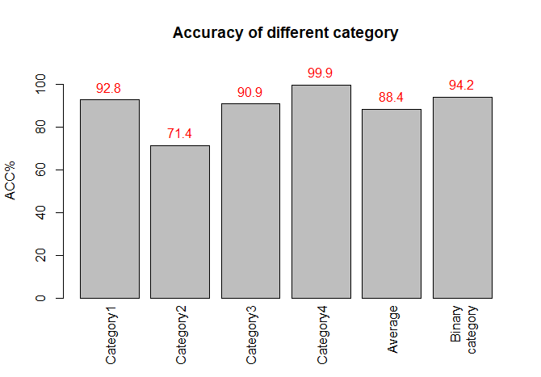
N-Sensing
Category 1, Category 2, Category 3, and Category 4 represent four N treatments (0, 6, 12, and 20 g/L) in the greenhouse experiment.
Binary category: (Category1+Category2) & (Category3+Category4)

Slide 7
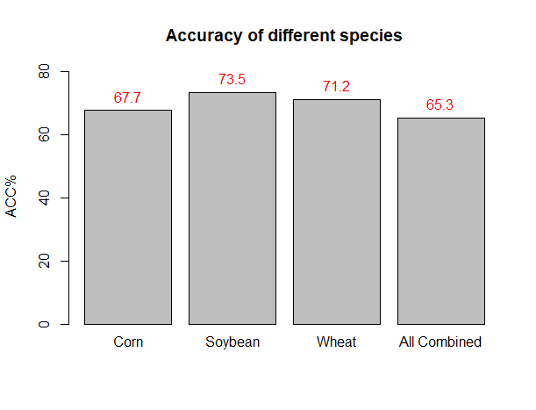
P-Sensing

